Slide 1

MY 3-MONTH INTERNSHIP EXPERIENCE IN
DIGITAL MARKETING
Internship Period: December 05, 2024 – April 10, 2025
PRESENTED BY: RABINDRA ACHARYA

Slide 2


About Company
Company Name: Nep Tech Pal Pvt. Ltd
Location: Jalparoad, Pokhara
Services Provided: digital marketing, web development, mobile app development, system design, and software solutions.
3

Slide 3
Objectives of Internship
Learn and apply digital marketing tools (Canva, Meta Ads, Ubersuggest, etc.)
Gain practical experience in content creation and blog writing
Understand how to run and manage social media ad campaigns
Improve SEO knowledge and basic keyword research skills
Develop soft skills like communication, creativity, and
time management.
3

Slide 4
Tools & Platforms I Used
Meta Ads Manager
Canva
Trello
SEMrush
Google Workspace
Elementor
Whatsapp
4

Slide 5

Key Projects & Campaigns
1
Content Creation for Loksewa Tayari App
Ad Campaign for:
College Coach Nepal
Little Darlings
Delight Eyes Academy
Saru Collection
Blissfancycolletion -simara
एरिका डेभलपर्स प्रा. लि
श्रेष्ठ कोल्ड स्टोर, Alwass
वैदेशिक रोजगार नेपाल
6

Slide 6
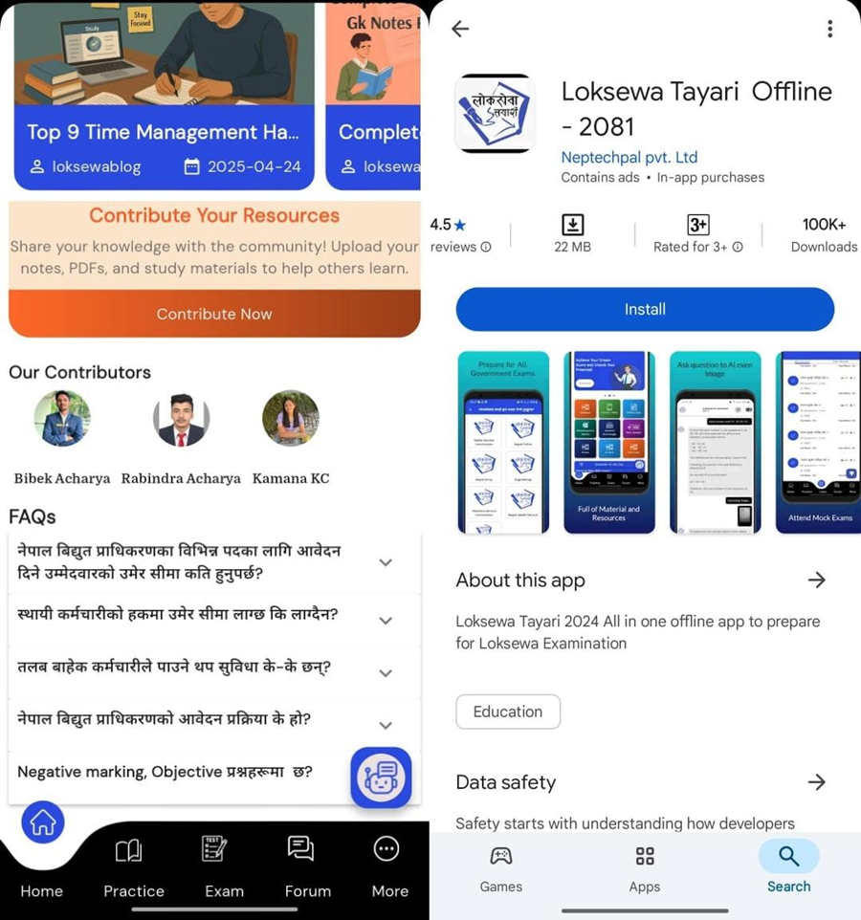

Slide 7
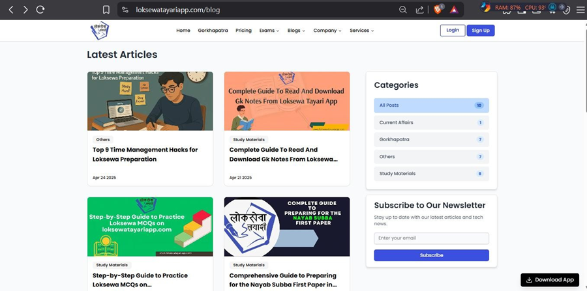

Slide 8
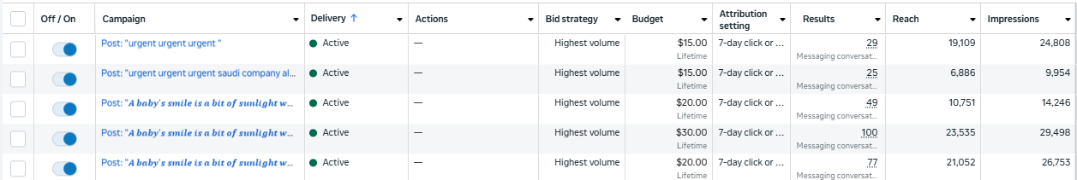

Slide 9

Skills I Learned
Technical / Digital Marketing Skills
Soft Skills
Social Media Content Creation
Blog Writing & SEO Basics
Facebook & Instagram Ads Setup
Keyword Research (Semrush)
Post Scheduling (Meta Business Suite)
Desingning social media post ,blog feature image from Canva
Time Management
Communication & Collaboration
Creative Thinking
Attention to Detail
Problem Solving
Working with real-clients
8

Slide 10

Challenges I Faced
Ad account setup and targeting was confusing at first.
Managing time between blog writing and post design.
Creating fresh and creative content regularly.
Understanding analytics reports in the beginning.
Making content both creative and informative.
Struggled to create eye-catching designs in the beginning.
Time management while handling multiple tasks.
8

Slide 11
What I Gained ?
Practical experience in digital marketing.
Content creation for social media & blogs.
Running Facebook & Instagram ad campaigns.
Basic SEO knowledge & keyword research.
Improved design skills using Canva.
Better time management and task handling.
Confidence in communication and teamwork.
Understanding real client needs.
8

Slide 12
Gratitude & Future Goals
Grateful to my mentors and team for their constant support.
Thankful for the opportunity to work on real projects.
Learned valuable skills that will help in my career.
Planning to explore advanced digital marketing tools.
Aim to build a strong career in content Creation and advertising.
Excited to keep learning and growing in this field.
8

Slide 13
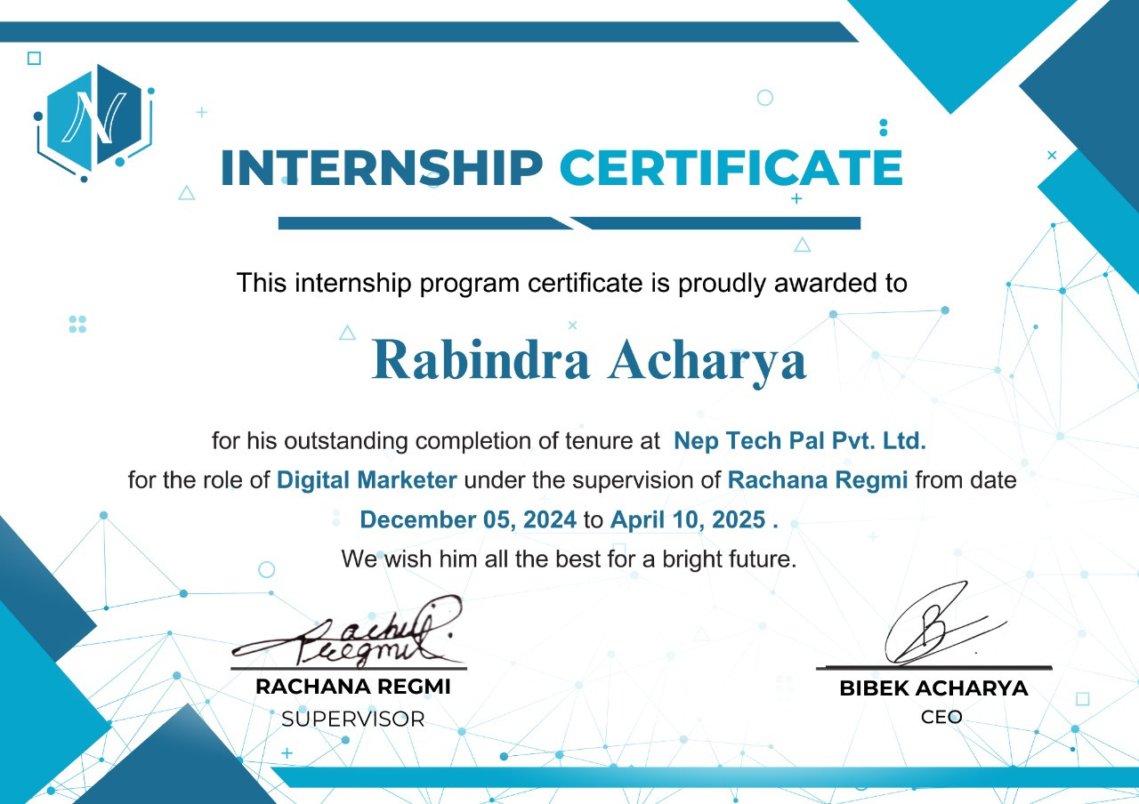

Slide 14
THANK YOU !
9

